Slide 1
Solve Polynomial Equations
Algebra 2
Chapter 4

Slide 2
This Slideshow was developed to accompany the textbook
  Big Ideas Algebra 2
  By Larson, R., Boswell
  2022 K12 (National Geographic/Cengage)
Some examples and diagrams are taken from the textbook.
Slides created by
Richard Wright, Andrews Academy
rwright@andrews.edu

Slide 3
4-01 Add, Subtract, and Multiply Polynomials (4.2)
Objectives:
Add and subtract polynomial expressions.
Multiply polynomial expressions.

Slide 4
4-01 Add, Subtract, and Multiply Polynomials (4.2)
Adding, subtracting, and multiplying are always good things to know how to do.
Sometimes you might want to combine two or more models into one big model.

Slide 5
4-01 Add, Subtract, and Multiply Polynomials (4.2)
Adding and subtracting polynomials
  Add or subtract the coefficients of the terms with the same power.
  Called combining like terms.
Simplify
  (5x² + x – 7) + (−3x² – 6x – 1)
  (3x³ + 8x² – x – 5) – (5x³ – x² + 17)
Notes:
2x² – 5x – 8
−2x³ + 9x² – x – 22

Slide 6
4-01 Add, Subtract, and Multiply Polynomials (4.2)
Multiplying polynomials
  Use the distributive property
Simplify
  (x – 3)(x + 4)
  (x + 2)(x² + 3x – 4)
Notes:
x·x + 4x − 3x − 12 → x² + x – 12
x·x² +x·3x − x·4 + 2·x² + 2·3x − 2·4 → x³ + 3x² – 4x + 2x² + 6x – 8 → x³ + 5x² + 2x – 8

Slide 7
4-01 Add, Subtract, and Multiply Polynomials (4.2)
(x – 1)(x + 2)(x + 3)
Notes:
(x² + 2x – 1x – 2)(x + 3) → (x² + x – 2)(x +3) → x²(x + 3) + x(x + 3) – 2(x + 3) → x³ + 3x² + x² + 3x – 2x – 6 → x³ + 4x² + x – 6

Slide 8
4-01 Add, Subtract, and Multiply Polynomials (4.2)
Special Product Patterns
  Sum and Difference
    (a – b)(a + b) = a² – b²
  Square of a Binomial
    (a ± b)² = a² ± 2ab + b²
  Cube of a Binomial
    (a ± b)³ = a³ ± 3a²b + 3ab² ± b³

Slide 9
4-01 Add, Subtract, and Multiply Polynomials (4.2)
(x + 2)²
(x – 3)²
Notes:
(x + 2)(x + 2) → x² + 2(2x) + 2² → x² + 4x + 4
x² + 2(−3x) + (−3)² → x² − 6x + 9

Slide 10
4-02 Factor and Solve Polynomial Equations (4.4)
Objectives:
Factor polynomial expressions.
Solve polynomial equations by factoring.

Slide 11
4-02 Factor and Solve Polynomial Equations (4.4)
A manufacturer of shipping cartons who needs to make cartons for a specific use often has to use special relationships between the length, width, height, and volume to find the exact dimensions of the carton.
The dimensions can usually be found by writing and solving a polynomial equation.
This lesson looks at how factoring can be used to solve such equations.

Slide 12
4-02 Factor and Solve Polynomial Equations (4.4)
How to Factor
Greatest Common Factor
  Comes from the distributive property
  If the same number or variable is in each of the terms, you can bring the number to the front times everything that is left.
  3x²y + 6xy – 9xy² =
  Look for this first!
Notes:
3xy(x + 2 – 3y)

Slide 13
4-02 Factor and Solve Polynomial Equations (4.4)
Check to see how many terms
  Two terms (formulas)
    Difference of two squares: a² – b² = (a – b)(a + b)
      9x² – y⁴ =
    Sum of Two Cubes: a³ + b³ = (a + b)(a² – ab + b²)
      8x³ + 27 =
    Difference of Two Cubes: a³ – b³ = (a – b)(a² + ab + b²)
      y³ – 8 =
Notes:
(3x – y²)(3x + y²)
(2x + 3)(4x² – 6x + 9)
(y – 2)(y² + 2y + 4)

Slide 14
4-02 Factor and Solve Polynomial Equations (4.4)
Three terms (General Trinomials → ax² + bx + c)
  Write two sets of parentheses ( )( )
  Guess and Check
    The Firsts multiply to make ax²
    The Lasts multiply to make c
    The Outers + Inners make bx
  x² + 7x + 10 =
  6x² – 7x – 20 =
Notes:
(x+2)(x+5)
(2x – 5)(3x + 4)

Slide 15
4-02 Factor and Solve Polynomial Equations (4.4)
Four terms (Grouping)
    Group the terms into sets of two so that you can factor a common factor out of each set
    Then factor the factored sets (Factor twice)
  b³ – 3b² – 4b + 12 =
Notes:
(b³ – 3b²) + (-4b + 12) = b²(b – 3) + -4(b – 3) = (b – 3)(b² − 4) = (b − 3)(b − 2)(b + 2)

Slide 16
4-02 Factor and Solve Polynomial Equations (4.4)
Try factoring more!
  a²x – b²x + a²y – b²y =
Notes:
x(a² – b²) + y(a² – b²) = (x + y)(a² – b²) = (x + y)(a – b)(a + b)

Slide 17
4-02 Factor and Solve Polynomial Equations (4.4)
3a²z – 27z =
n⁴ – 81 =
Notes:
3z(a² – 9) = 3z(a – 3)(a + 3)
(n² – 9)(n² + 9) = (n² + 9)(n – 3)(n + 3)

Slide 18
4-02 Factor and Solve Polynomial Equations (4.4)
Solving Equations by Factoring
  Make = 0
  Factor
  Make each factor = 0 because if one factor is zero, 0 time anything = 0

Slide 19
4-02 Factor and Solve Polynomial Equations (4.4)
2x⁵ = 18x
Notes:
$$2x^{5}−18x=0$$
$$2x(x^{4}−9)=0$$
$$2x(x^{2}−3)(x^{2}+3)=0$$
$$2x=0, x^{2}−3=0, x^{2}+3=0$$
$$x=0, ±\sqrt{3}, ±\sqrt{3}i$$

Slide 20
4-03 Divide Polynomials (4.3)
Objectives:
Divide polynomials with long division.
Divide polynomials with synthetic division.

Slide 21
4-03 Divide Polynomials (4.3)
So far we done add, subtracting, and multiplying polynomials.
Factoring is similar to division, but it isn’t really division.
Today we will deal with real polynomial division.

Slide 22
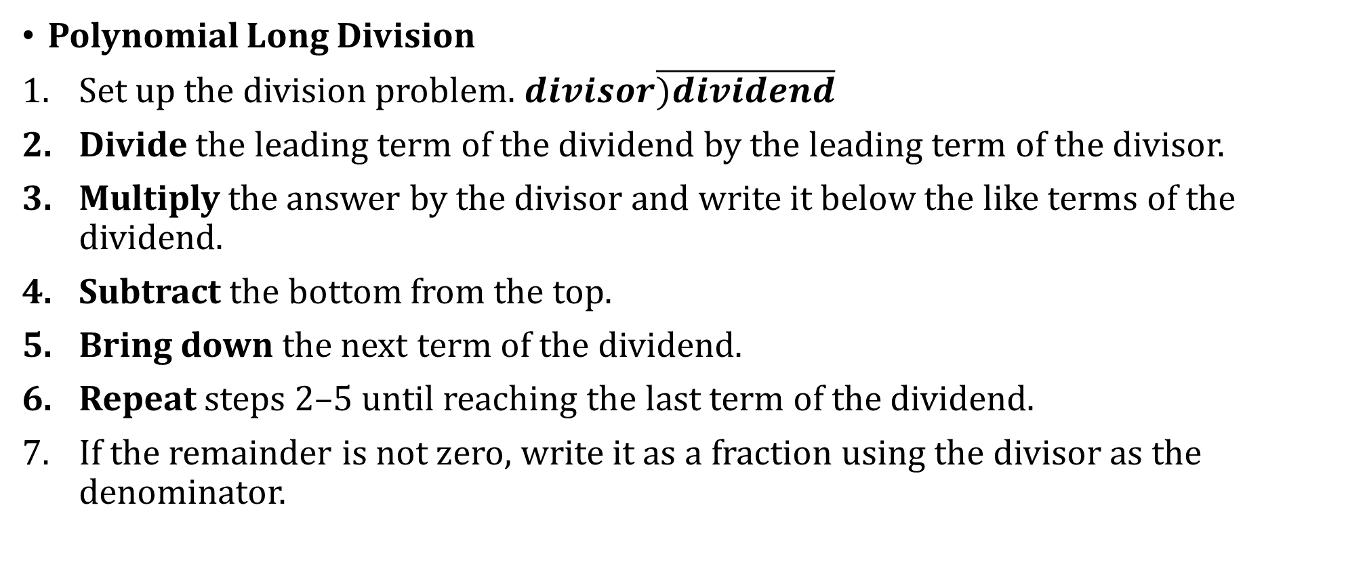
4-03 Divide Polynomials (4.3)
Polynomial Long Division
Set up the division problem. $divisor\overline{)dividend}$
Divide the leading term of the dividend by the leading term of the divisor.
Multiply the answer by the divisor and write it below the like terms of the dividend.
Subtract the bottom from the top.
Bring down the next term of the dividend.
Repeat steps 2–5 until reaching the last term of the dividend.
If the remainder is not zero, write it as a fraction using the divisor as the denominator.

Slide 23

4-03 Divide Polynomials (4.3)
$$\frac{y^{4}+2y^{2}−y+5}{y^{2}−y+1}$$
Notes:
y² + y + 2
y² − y + 1)y⁴ + 0y³ + 2y² − y + 5
− y⁴ − y³ + y²
y³ + y² − y
− y³ − y² + y
2y² − 2y + 5
− 2y² − 2y + 2
3
$$y^{2}+y+2+\frac{3}{y^{2}−y+1}$$

Slide 24

4-03 Divide Polynomials (4.3)
$$\frac{x^{3}+4x^{2}−3x+10}{x+2}$$
Notes:
x² + 2x − 7
x + 2 ) x³ + 4x² − 3x + 10
− x³ + 2x²
2x² − 3x
− 2x² + 4x
−7x + 10
− −7x − 14
24
$$x^{2}+2x−7+\frac{24}{x+2}$$

Slide 25
4-03 Divide Polynomials (4.3)
Synthetic Division
  Shortened form of long division for dividing by a binomial
  Only when dividing by (x – k)

Slide 26
4-03 Divide Polynomials (4.3)
Synthetic Division
To divide a polynomial by x − k,
Write k for the divisor.
Write the coefficients of the dividend.
Bring the lead coefficient down.
Multiply the lead coefficient by k. Write the product in the next column.
Add the terms of the second column.
Multiply the result by k. Write the product in the next column.
Repeat steps 5 and 6 for the remaining columns.
Use the bottom numbers to write the quotient. The number in the last column is the remainder, the next number from the right has degree 0, the next number from the right has degree 1, and so on. The quotient is always one degree less than the dividend.

Slide 27
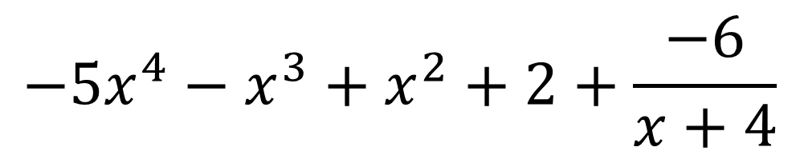
4-03 Divide Polynomials (4.3)
Synthetic Division
  (−5x⁵ − 21x⁴ – 3x³ + 4x² + 2x +2) / (x + 4)
Coefficients with placeholders
-4
-
5
-21
-3
4
2
2
20
4
-4
0
-8
-
5
-
1
1
0
2
-6
$$−5x^{4}−x^{3}+x^{2}+2+\frac{−6}{x+4}$$

Slide 28
4-03 Divide Polynomials (4.3)
(y⁵ + 32)÷(y + 2)
y⁴ – 2y³ + 4y² – 8y + 16
-2
1
0
0
0
0
32
-2
4
-8
16
-32
1
-
2
4
-8
16
0

Slide 29
4-04 Find Rational Zeros of Polynomial Functions (4.5)
Objectives:
Evaluate a polynomial using the remainder theorem.
List the possible rational zeros of a polynomial.
Find the rational zeros of a polynomial.

Slide 30
4-04 Find Rational Zeros of Polynomial Functions (4.5)
The Remainder Theorem
  If a polynomial f(x) is divided by x − k, then the remainder is the value f(k).
Use the Remainder Theorem to Evaluate a Polynomial
  To evaluate polynomial f(x) at x = k using the Remainder Theorem,
  Use synthetic division to divide the polynomial by x − k.
  The remainder is the value f(k).

Slide 31

4-04 Find Rational Zeros of Polynomial Functions (4.5)
Use the remainder theorem to evaluate $f\left(x\right)=3x^{4}−5x^{3}+x−14$ at x = 2.
Notes:
Use synthetic division with x − 2.
f(2) = −4

Slide 32
4-04 Find Rational Zeros of Polynomial Functions (4.5)
The Factor Theorem
According to the Factor Theorem, k is a zero of f(x) if and only if (x − k) is a factor of f(x).
Use the Factor Theorem to Solve a Polynomial Equation
To solve a polynomial equation given one factor using the factor theorem,
Use synthetic division to divide the polynomial by the given factor, (x − k).
Confirm that the remainder is 0.
If the quotient is NOT a quadratic, repeat steps 1 and 2 with another factor using the quotient as the polynomial.
If the quotient IS a quadratic, factor the quadratic quotient if possible.
Set each factor equal to zero and solve for x.

Slide 33
4-04 Find Rational Zeros of Polynomial Functions (4.5)
Show that x – 2 is a factor of x³ + 7x² + 2x – 40. Then find the remaining factors.
Notes:
Use synthetic division with x − 2. Factor the quotient (depressed polynomial) to get the remaining factors.
All factors are (x + 4)(x + 5)(x – 2)

Slide 34
Show that x + 2 and x − 1 are factors of x⁴ − 4x³ − 3x² + 14x – 8. Then find the remaining factors.
Notes:
Use synthetic division with x + 2. The depressed polynomial is not a quadratic.
Use synthetic division with x − 1 with the depressed polynomial.
The new depressed polynomial is quadratic. Factor the quotient (depressed polynomial) to get the remaining factors.
All factors are (x + 2)(x − 1)²(x – 4)

Slide 35
4-05 Find All Zeros of Polynomial Functions (4.6)
Objectives:
Apply the fundamental theorem of algebra to find all the zeros of a polynomial.
Apply the irrational conjugate theorem to write a polynomial given rational, irrational, and imaginary zeros.

Slide 36

4-04 Find Rational Zeros of Polynomial Functions (4.5)
Rational Zero Theorem
  Given a polynomial function, the rational zeros will be in the form of $\frac{p}{q}$ where p is a factor of the last (or constant) term and q is the factor of the leading coefficient.

Slide 37
4-04 Find Rational Zeros of Polynomial Functions (4.5)
List all the possible rational zeros of
f(x) = 2x³ + 2x² − 3x + 9
Notes:
p = ±1, ±3, ±9
q = ±1, ±2
p/q = ±1, ±1/2, ±3, ±3/2, ±9, ±9/2

Slide 38
4-05 Find All Zeros of Polynomial Functions (4.6)
Use the Rational Zero Theorem and Synthetic Division to Find Zeros of a Polynomial
To find all the zeros of polynomial functions,
Use the Rational Zero Theorem to list all possible rational zeros of the function.
Use synthetic division to test a possible zero. If the remainder is 0, it is a zero. The x-intercepts on a graph are zeros, so a graph can help you choose which possible zero to test.
Repeat step two using the depressed polynomial with synthetic division. If possible, continue until the depressed polynomial is a quadratic.
Find the zeros of the quadratic function by factoring or the quadratic formula.

Slide 39
4-04 Find Rational Zeros of Polynomial Functions (4.5)
Find all zeros of f(x) = x³ − 4x² − 2x + 20
Notes:
List possible rational zeros;
P = ±1, ±2, ±4, ±5, ±10, ±20
q = ±1
p/q = ±1, ±2, ±4, ±5, ±10, ±20
Use a graph to find an x-intercept that appears to be one of the rational zeros. (−2)
Use synthetic division to verify that it is a zero.
Since the remainder was zero −2 is a root and the depressed polynomial is x² – 6x + 10
Repeat the process on the depressed polynomial until you get a quadratic for the depressed polynomial then use the quadratic formula
x = 3 ± i, -2

Slide 40
4-05 Find All Zeros of Polynomial Functions (4.6)
The Fundamental Theorem of Algebra
If f(x) is a polynomial of degree n > 0, then f(x) has at least one complex zero.
A polynomial has the same number of zeros as its degree.

Slide 41
4-05 Find All Zeros of Polynomial Functions (4.6)
How many solutions does x⁴ − 5x³ + x − 5 = 0 have? Find all the solutions.
Notes:
Four solutions
Factorable by grouping
$$x^{4}−5x^{3}+x−5=0$$
$$x^{3}\left(x−5\right)+1\left(x−5\right)=0$$
$$\left(x^{3}+1\right)\left(x−5\right)=0$$
$$\left(x+1\right)\left(x^{2}−x+1\right)\left(x−5\right)=0$$
$$x+1=0;x^{2}−x+1=0;x−5=0$$
$$x=−1;x=\frac{1}{2}±\frac{\sqrt{3}}{2}i;x=5$$

Slide 42

4-05 Find All Zeros of Polynomial Functions (4.6)
Given a function, find the zeros of the function.
$f\left(x\right)=x^{4}−6x^{3}+9x^{2}+6x−10$
Notes:
Not factorable
Find p’s, q’s, and p/q
p = ±1, ±2, ±5, ±10
q = ±1
p/q = ±1, ±2, ±5, ±10
Use a graph to choose a p/q which is an x-intercept (1)
Use synthetic division to check to see if it is a factor (it is)
The depressed polynomial is not a quadratic, so use another x-intercept (−1)
Use synthetic division with the depressed polynomial to check to see if it is a factor (it is)
The depressed polynomial is a quadratic, so use the quadric formula to solve.
The zeros are 1, −1, 3 ± i

Slide 43
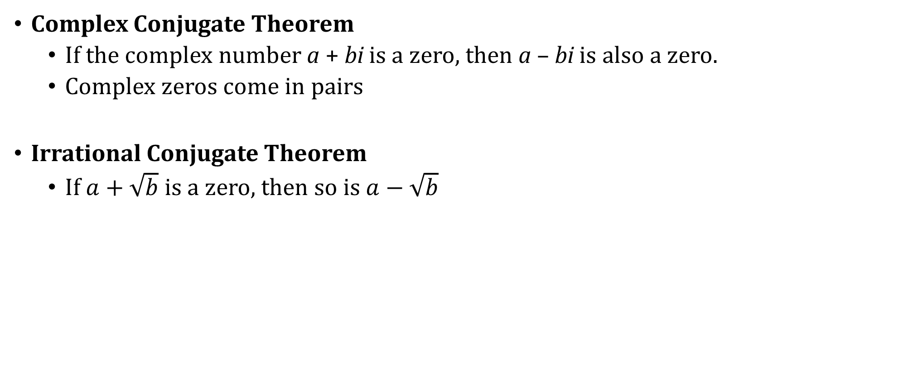
4-05 Find All Zeros of Polynomial Functions (4.6)
Complex Conjugate Theorem
  If the complex number a + bi is a zero, then a – bi is also a zero.
  Complex zeros come in pairs
Irrational Conjugate Theorem
  If $a+\sqrt{b}$ is a zero, then so is $a−\sqrt{b}$

Slide 44
4-05 Find All Zeros of Polynomial Functions (4.6)
Write a polynomial function that has the given zeros. 2, 4i
Notes:
Don’t forget −4i is also a zero.
Write factors as (x − k) where k are the zeros
(x – 2)(x – 4i)(x + 4i)
(x – 2)(x² – 16i²)
(x – 2)(x² + 16)
x³ − 2x² + 16x − 32

